Slide 1
Four Trials to Crack the Child Helmet Quandary
The Fourth International Conference of the Thai Society for Transport and Traffic Studies
Ratanawadee H. WINTHER, AIP Foundation
Thursday, April 2, 2015

Slide 2
CONTENT
Child helmet use in Thailand
Design of the trials
Trial 1: Helmet bank
Trial 2: Police enforcement
Trial 3: Petrol station retail
Trial 4: Taxi stands
Conclusions

Slide 3
CHILD HELMET USE IN THAILAND
Notes:
Road crashes are among the world’s foremost public health issues with 1.24 million deaths and 20-50 million injuries per year. (World Health Organization, 2013) Thailand ranks second in road traffic deaths per population worldwide. (Michael Sivak and Brandon Schoettle, 2014) Motorcyclists account for 73% of Thailand’s road deaths. (World Health Organization, 2013) Road injury is the second leading cause of death among children aged 10-14 in Thailand. (Lozano et al., 2012) Even though Thai law has mandated helmet use for motorcycle drivers and passengers since 1996, fewer than half of motorcyclists, and only 7% of children wear helmets nationwide. (ThaiRoads Foundation et al., 2013)
Road crashes are #1 cause of injury and disability/2,600 Thai children die/72,680 are injured: (http://www.paidouai.org/wa_files/Thai_20child_20report_20-_20child_20injury_20in_20thailand.pdf)
2nd highest rate of deaths from crashes: (http://global.umich.edu/2014/02/thai-roads-ranked-no-2-for-traffic-deaths) 1.3 million but only 7% wear helmets: (Thai Roads Foundation http://trso.thairoads.org/resources/5421)

Slide 4
CHILD HELMET USE IN THAILAND
Notes:
Helmets are proven to reduce the risk of head injury by 69% and death by 42% in a crash. (Liu et al., 2008)
Most crashes happen within 6 mins:
(Motorcycle Accident Causation and Identification of Countermeasures Volume II: Upcountry Study in Thailand by Vira Kasantikul, M.D. Chulalongkorn University)
3 main reasons Thais do not wear helmets:
(http://trso.thairoads.org/resources/5407)

Slide 5
DESIGN OF THE FOUR TRIALS
From November 2013 to January 2014, AIP Foundation conducted four trials for two to three weeks each at locations throughout Bangkok. This presentation describes the methodology, findings, and recommendations of each trial.
Table 1: Four trials tested to increase child helmet use in Bangkok
 | Name of Trial | Description
Trial 1 | Helmet Bank | Loaning helmets to students from within schools
Trial 2 | Police Enforcement | Law enforcement by police officers at school gates
Trial 3 | Petrol Station Retail | Convenient accessibility through helmet retail kiosks at petrol stations
Trial 4 | Taxi Stand | Motorcycle taxi drivers offer helmets to all child passengers
Notes:
To identify possible models to increase child helmet use, the Asia Injury Prevention (AIP) Foundation, in collaboration with Save the Children and the Road Safety Fund, conducted four small-scale trials (see Table 1) to pilot innovative ideas for increasing child helmet use in Thailand. The overall objective in conducting the trials was to identify initiatives that would be most suitable, in terms of sustainability and impact, for expansion.
Trials 1, 2, and 4 were modeled on a pre-test, implementation, post-test design. The helmet wearing rate of children traveling to the school by motorcycle was measured before and after the trial based on AIP Foundation’s helmet observation methodology. Focus group discussions and in-depth interviews were conducted with key stakeholders after the trials ended in order to gain their insights on the trials and on factors that motivate or hinder child helmet use.
Trial 3 was modeled on an implementation, investigation design. During the 2-3 week trial, customers completed a short questionnaire or were interviewed on-site about the trial, possible motivations, and barriers for helmet purchase and use.

Slide 6
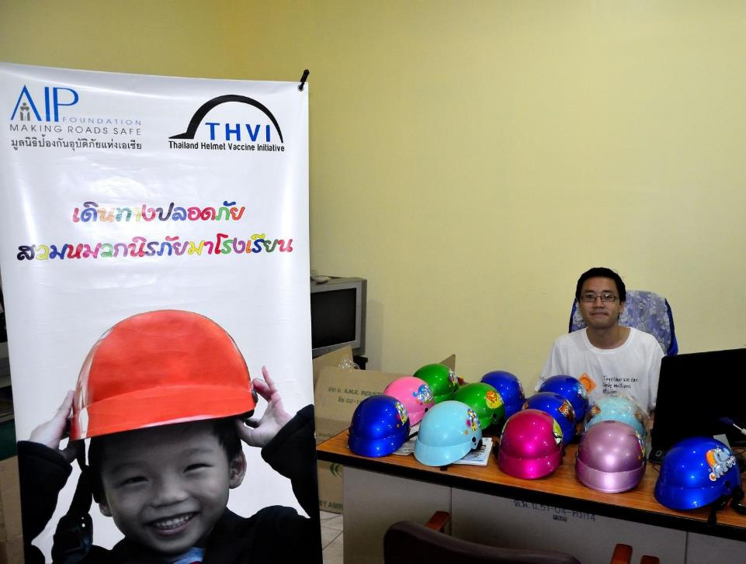
Methodology
TRIAL 1: HELMET BANK
Where: Ban Nong Bon Primary School in Suan Luang, Bangkok
When: November 21 - December 12, 2013
What: Helmets provided at school for students to borrow – similar to school library for helmets
Notes:
In Thailand, child helmets are available through direct purchase or donation via educational schemes operated by government agencies, private corporations, and non-governmental organizations (NGOs). This trial aimed to test whether school-based helmet loans could increase child helmet use.
Ban Nong Bon Primary School in Suan Luang, Bangkok was selected for the trial, because nearly half of its students travel by motorcycle, it is in close proximity to a major road, and helmet use is low. Students who traveled by motorcycle regularly, but did not regularly wear helmets when riding on motorcycles (making up about 30% of the school body), were targeted for the project. The trial was implemented from November 21 - December 12, 2013.
A “helmet bank” was established on the school grounds and operated each school day. The helmet bank stored 200 child helmets for students to borrow. Borrowers could keep helmets for a maximum of three days but could borrow helmets again if they wished.
Before implementation, AIP Foundation conducted a helmet observation and a training workshop. The observation took place at the school gate to assess baseline helmet use among students. The one-hour training workshop with 200 target students covered road safety, the importance of helmet wearing, and how to wear a helmet properly. It also introduced the helmet bank and how to access a helmet through the helmet bank.
During implementation, several activities aimed to increase awareness about the importance of child helmet use among parents and teachers. At the beginning of the trial, teachers informed parents about the helmet bank as they collected their children from school. Children informed their parents when they borrowed helmets from the helmet bank. Helmet observations assessed helmet use during and after the trial.
After implementation, AIP Foundation conducted two focus group discussions with students who borrowed helmets and one with teachers at the trial school about their perception of the helmet bank and insights on helmet use.

Slide 7
TRIAL 1: HELMET BANK
Key findings
Insights
On average, 60% of target students borrowed helmets during the trial. However, very few were wearing the borrowed helmets.
Parents were concerned about students losing helmets
Helmet bank was perceived by school staff as high value activity
Notes:
During the trial, a high proportion of students borrowed helmets at the bank. Daily borrowing rates ranged from 59% (with 117 out of 200 helmets borrowed) to 64% (128 helmets borrowed). On average, 60% of target students borrowed helmets during the trial.
Helmet use among students traveling on motorcycles at Ban Nong Bon Primary School increased from 8.8% prior to the trial, to 18.6% after the trial (see Figure 1). While a significant number of children borrowed helmets from the helmet bank, very few were wearing the borrowed helmets. The findings showed that child helmet use at the trial school more than doubled in only three weeks, but this increase did not parallel the rate of participation at the helmet bank. If all the children who borrowed helmets wore them, the rate of helmet use would be around 60%. The actual change in helmet use (of 9.8 percentage points) is equivalent to only 16 additional children wearing helmets.
A focus group discussion among students borrowing helmets revealed that students did not have their own child-sized helmets. Before the trial, some students wore their parents’ helmets, but they expressed that they did not like wearing the adult helmets due to the size and weight. The students said that they borrowed helmets to protect them from road injury. Many students responded that certain styles, based on helmet size, color selection, appealing designs, and windshields, would motivate them to wear helmets.
Teachers were very enthusiastic about continuing the helmet bank initiative beyond the trial period and suggested a cluster model expansion, in which a group of schools would each implement helmet banks, under the guidance of one lead school. Teachers emphasized the value of educational activities to inform children about the importance of correct helmet use. They suggested that further activities on road safety could be adapted and delivered by teachers in the classroom and that the involvement of police in delivering these activities would further engage the children.
The helmet bank trial increased helmet use at the trial school and received enthusiastic support among teachers. That the helmets borrowed from the bank were free of charge created a perception of high value within the school, but due to concerns of hygiene, parents were also interested in purchasing helmets. The helmet bank’s capacity to draw attention to the importance of helmet wearing is a valuable lesson. The school environment is an ideal setting to communicate messages to students, parents, and the wider community about child helmet wearing. The helmet bank, perhaps incorporating an element of helmet retail to meet demand from parents, can act as the focal point of these communications.
The greatest potential cost of implementing helmet banks at scale would be the acquisition and maintenance of the helmets. This trial was implemented at “no cost” to the school. To implement helmet banks at scale, there would need to be careful consideration of resourcing. If resources were more limited, requiring additional commitment from schools, this may impact schools’ support and in turn reduce the effectiveness of the helmet bank itself.
Despite its benefits, the trial faced several barriers that prevented children from wearing helmets. These barriers indicate the need to invest more on behavior change if the trial is expanded. The trial could be improved upon by addressing the identified barriers, integrating comprehensive educational activities, and encouraging teachers to enforce child helmet use.

Slide 8
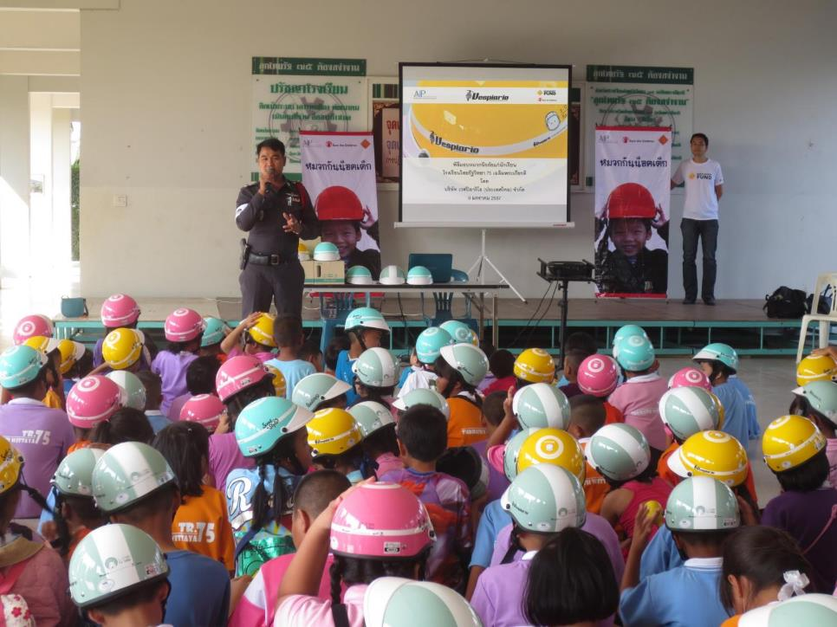
Methodology
TRIAL 2: POLICE ENFORCEMENT
Where: Thai Rath Wittaya 75 School in Sai Mai, Bangkok
When: November 25, 2013 – January 9, 2014
What: Police enforced helmet law at checkpoint at school entrance
Notes:
Although Thai law requires all motorcyclists to wear helmets, this mandate is not widely or consistently enforced by the police and, as a result, helmet use is low nationwide. Experience from road safety interventions around the world has shown that increased enforcement leads to an increase in helmet wearing. (Pervin, 2009; World Health Organization, 2009) This trial investigated the impact of increased police enforcement and its barriers.
Sai Mai Police Station is located close to Thai Rath Wittaya 75 School in Sai Mai, Bangkok, which was selected for the trial based on proximity to the police station, high rates of students traveling by motorcycle, and low helmet use. Officers from the station were asked to patrol the school’s entrance as children arrived and departed from the school for the duration of the trial. While patrolling, police officers were told to enforce the helmet wearing law.
Before the trial began on November 25, 2014, AIP Foundation conducted observations to assess baseline helmet use. For the first week, traffic police verbally warned parents whose children were traveling without helmets. In the second week of the trial, traffic police issued fines to parents whose children were traveling without helmets. In the third week, traffic police gave away rewards for children wearing helmets. The trial finished on December 14, 2013. On January 9, 2014, AIP Foundation conducted post-implementation helmet observations and focus group discussions with participating police, students, and teachers.

Slide 9
TRIAL 2: POLICE ENFORCEMENT
Key findings
Insights
Limited number of fines/warnings issued
Limited increase in helmet wearing
Limited police resources due to protests
Need to combine enforcement with community engagement activities
Notes:
Students reported that their encounters with police patrols usually ended with warnings instead of fines and a few reported that their parents gave them adult helmets on the following days. Other students reported that they saw police officers infrequently, indicating that the police presence was inadequate as a visual deterrent. Students reported awareness of the importance of wearing helmets to protect themselves from injury in road crashes, and they said they felt good seeing police in front of the school.
Teachers reported that police enforcement is not a significant motivating factor for children to wear helmets and that police enforcement would instead impact the behavior of motorcycle taxi drivers, whose income would be directly affected by child passengers without helmets.
Despite the support of the head of traffic police at the Sai Mai Police Station, securing sufficient resources for the trial was challenging. Originally, police were asked to establish a checkpoint at the entrance of the school with many police officers to issue warnings and fines. A prominent checkpoint was hoped to be a visual deterrent to discourage children from riding motorcycles without helmets. At the time of the trial, there were significant demands on the Royal Thai Police throughout Bangkok. Ultimately, only one officer from the station was released to participate in the trial, so a prominent checkpoint was not possible.
In focus group discussions, traffic police explained their discomfort with enforcing the helmet law due to its potentially negative impact on their relationship with the local community. To fine children not wearing helmets seemed to them an inappropriate practice. The police officers also advised that, regardless of resources, it would not be possible to create a checkpoint outside a school as it would cause problems with traffic flow around the school.
Officers also mentioned a lack of resources for patrolling and enforcing the helmet law among children and suggested that efforts to increase enforcement should focus on negotiations with high levels of the Royal Thai Police. The police needed to protect its image due to demonstrations in Thailand during the trials. Any actions within the community had to be carefully managed. Successful advocacy with the leaders of the Royal Thai Police would hopefully provide the support for local police to increase enforcement of the helmet law.
When asked about the most effective way to increase child helmet use, the police officers felt that education or reminders, not increased enforcement, was the best option. They expressed that enforcement should be the final measure taken after education and awareness raising. If additional support was provided by the Royal Thai Police, the officers suggested that police could engage with and inform the community of the need to wear helmets.
In this trial, the increase in children’s helmet wearing was limited, possibly due to the police officers’ unwillingness to issue fines for those who did not wear helmets. Insufficient police resources available for the trial were also a barrier to improved enforcement.
Future initiatives need to account for police sensitivities about community reaction and include components that allow police to address community concerns. The trial could be improved through continued high-level negotiations to increase police enforcement of the helmet law and supplemental activities to allowing local police officers to provide education about the importance of child helmet use, the helmet law, and law enforcement activities to combat negative reactions in the community.

Slide 10
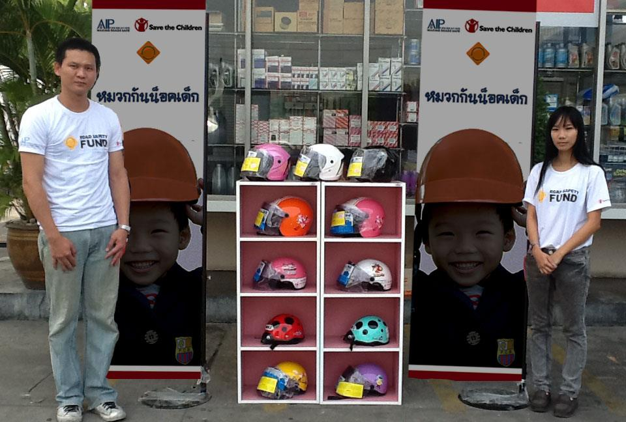
Methodology
TRIAL 3: PETROL STATION RETAIL
Where: Two petrol stations in high traffic locations
When: November 29, 2013 – January 19, 2014
What: Children’s helmets sold at retail kiosks at petrol stations
Notes:
In Thailand, the primary distribution channels for adult and child helmets are motorcycle and related accessory shops. Supermarkets are a comparatively minor retail channel. Prior research with manufacturers indicated that helmets had never been sold in petrol stations. (Rubinyi, 2013) This trial investigated if petrol stations could be viable helmet retail channels.
Two temporary retail kiosks were set-up to sell children’s helmets to customers of two petrol stations, selected in high traffic locations. One retail kiosk sold discounted children’s helmets from November 29 - December 29, 2013, while the second kiosk sold helmets at market price January 6 - 19, 2014. The kiosks were located outside the petrol stations’ offices with shelves to display the children’s helmets and vinyl banners displaying customized advertisements.
Two retail assistants were recruited to staff the kiosks. The retail assistants were trained to assist customers with queries, process transactions, and conduct interviews with customers about reasons for buying or not buying a helmet.

Slide 11
TRIAL 3: PETROL STATION RETAIL
Key findings
Insights
Helmet sales were very low: Four per day (55 total) at the discount kiosk and only two total over 13 days at the market price kiosk. Customers reported:
Cost and design were barriers to purchasing helmets
Safety and compliance with the law (not cost) were reasons for purchasing helmets
The difficulty of finding child helmets as a reason for their children not wearing helmets (of those customers, only 20% proceeded to purchase helmets)
Limited time at the petrol station
Accessibility and affordability not sufficient to trigger demand
Customers’ did not have enough time at petrol stations
Petrol stations pose challenges for inventory management
Trial 3 is not recommended for expansion.
Notes:
During the trial, helmet sales were very low. An average of four helmets per day (55 total over the trial period) were sold at the discounted trial kiosk. Only two were sold at the market price kiosk over a period of 13 days. The reasons for low sales were investigated through customer interviews and observation.
In interviews with 40 customers at the discount kiosk and with 17 customers at the market price kiosk, cost and design were the most-cited reasons parents did not purchase helmets. Safety and the helmet law were the main reasons cited by parents who did purchase helmets. Although many more discounted helmets were sold than market price helmets, none of the customers who purchased helmets cited cost as their primary motivation for purchasing.
Increasing accessibility was insufficient to motivate customers to purchase. Customers whose children did not wear helmets cited the difficulty of finding child helmets as a reason for their children’s behavior, but of those customers, only 20% proceeded to purchase helmets.
Although 73.7% of customers agreed that petrol stations would be convenient locations for helmet retail, most customers had limited time at the petrol station, and additional time would be required to ensure the helmets correctly fit their children. Adults often ride to the petrol station without their children, thus creating an additional barrier to purchasing helmets.
Furthermore, to establish helmet retail at a petrol station requires substantial investment of time and money to create a space to display and store helmets in a range of sizes and designs, in what is often a small retail environment.

Slide 12
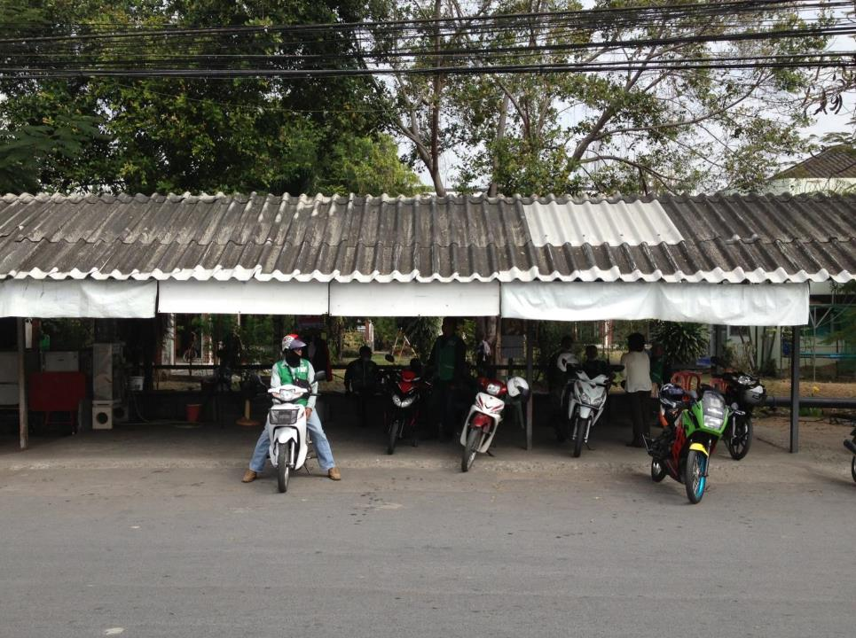
Methodology
TRIAL 4: TAXI STANDS
Where: Royal Thai Navy residential community and Sanpawut Wittaya School, Bang Na, Bangkok
When: January 2 - 17, 2014
What: Motorcycle taxi drivers offered helmets to all child passengers
Notes:
Motorcycle taxis are a popular means of transport in Thailand, and many children take motorcycle taxis to and from school. This trial investigated whether child helmet use would increase if motorcycle taxi drivers offer helmets to child passengers.
The trial was implemented from January 2 - 17, 2014. Two taxi stands located close to the Royal Thai Navy residential community and one taxi stand located close to Sanpawut Wittaya School in the Bang Na sub-district of Bangkok were selected for the trial. While the head of a motorcycle taxi drivers’ association supported the trial, drivers at the proposed taxi stands were not eager. A number of stands were consulted before the three trial stands were finalized. Two of the three selected stands were located at a Royal Thai Navy residential complex. Consequently, the Royal Thai Navy oversaw the operation of the stands.
The motorcycle taxi drivers were asked to offer helmets to child passengers, but they could still take a child passenger if they did not accept the helmet. If a child passenger refused the helmet, the motorcycle taxi driver would ask the child for his/her reason before commencing the trip. Child helmets, helmet storage, and helmet disinfectant spray were provided to the taxi stands for use during the trial.
Child helmet use was monitored at the two locations before the trial, one week after the trial began, and at the end of week three of implementation to observe any changes.

Slide 13
TRIAL 4: TAXI STANDS
Key findings
Insights
During the 16-day trial, taxi drivers offered helmets to 308 child passengers. Of those, 76% accepted the helmet.
Scalability is challenging due to independence of each taxi stand
Notes:
During the 16-day trial, taxi drivers offered helmets to 308 child passengers. Of those, 235 (76%) accepted the helmet (See Table 2). The number of drivers offering helmets to child passengers fluctuated throughout the trial and ultimately reduced over the period of the trial.
The finding of helmet observations in two locations (one near the community and one at the school) showed that rates significantly increased before and after the trial, from 0% prior to the trial, to more than 24% (See Figure 3).
The child passengers who did not accept helmets cited the short distance of the journey as the main reason for not wearing helmets. Others cited their dislike of helmets, size, and hygiene.
Although the Royal Thai Navy greatly facilitated the participation of two taxi stands, maintaining motorcycle taxi drivers’ participation was challenging. Each taxi stand operated in isolation, moreover, the motorcycle taxi drivers at each taxi stand also acted with a degree of autonomy. Initiatives focusing on motorcycle taxi drivers will need to motivate and educate them about the importance of child helmet use, in order to secure their commitment.
The trial showed that motorcycle taxi drivers can have an impact on children’s helmet wearing behavior. While there could be positive ripple effects influencing other children to wear helmets, the impact of initiatives focusing on motorcycle taxi drivers alone may be limited in audience. Motorcycle taxi drivers can persuade their child passengers to wear helmets, but this may not directly impact children who ride motorcycles with their parents or other relatives. This model would be best implemented in combination with other educational and advocacy initiatives to reach children who ride non-taxi motorcycles.
The trial would be improved on with continued negotiations with motorcycle taxi associations to engage taxi stands and increased educational communications to promote the importance of child helmet wearing among drivers.

Slide 14
CONCLUSIONS
The findings of all four trials indicate that child helmet use could be increased through a combination of the following interventions:
High-level negotiations to increase police enforcement of the helmet law
Communications to convert helmet access into helmet wearing
Leveraging teachers as champions of helmet wearing
Investigation of schools as channels for accessing helmets
Educational activities conducted by local police officers
Customized child helmets in visually desirable designs
Notes:
The helmet bank, police enforcement, and taxi stand trials resulted in increased child helmet wearing rates, but each trial had instructive challenges and strengths. The number of challenges presented by the petrol station retail trial in terms of customers’ time and demand, as well as inventory management, led to the conclusion that child helmet retail at petrol stations is not viable.
The findings of all four trials indicate that child helmet use could be increased through a combination of the following interventions:
1. High-level negotiations to increase police enforcement of the helmet law. Without high-level support, it is challenging for individual police stations and/or police officers to find the resources to enforce the helmet law.
2. Communications to convert helmet access into helmet wearing. Both the petrol station retail and the helmet loan bank results help demonstrate that access to helmets should not be the primary area of concern – in contrast, behavior change must be prioritized. Education, enforcement, and peer influence may motivate children to wear helmets, and encourage parents to acquire helmets.
3. Leveraging teachers as champions of helmet wearing. Teachers have significant influence on children’s behavior and parents’ attitudes. The helmet bank trial showed that teachers have the capacity to draw children’s and parents’ attention to helmet wearing.
4. Investigation of schools and taxi stands as channels for accessing helmets. The trials suggest that accessibility and cost of children’s helmets are not the primary obstacles to child helmet use. However, while helmet retail at petrol stations was proven to be unviable, schools and taxi stands can be effective channels for helmet loans and retail.
5. Educational activities conducted by local police officers. Police are eager to inform the community about the helmet law and enforcement and raise awareness that police enforcement of the helmet law saves lives.
6. Customized child helmets in visually desirable designs. Based on students’ feedback during the helmet bank trial, the range of helmet design choices should include new and trendy designs, popular cartoon characters, and various color options.

Slide 15
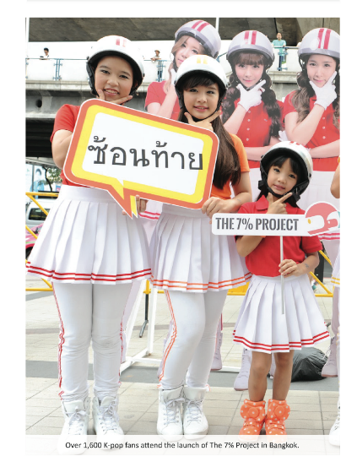
THANK YOU
For more information:
Visit www.asiainjury.org
Find us on Facebook
Follow us on Twitter
Contact:
Ratanawadee H. WINTHER
AIP Foundation Thailand
2, Prima Sathon Building, Room 8302, Naradhiwas Rajanagarindra Roud, Yannawa, Sathorn, Bangkok 10120, Thailand
ratana.winther@aipf-thailand.org

